Slide 1
Folder icon
through Windows versions

Slide 2

Windows 3.0

Slide 3

Windows 95

Slide 4

Windows 2000

Slide 5


Windows XP

Slide 6
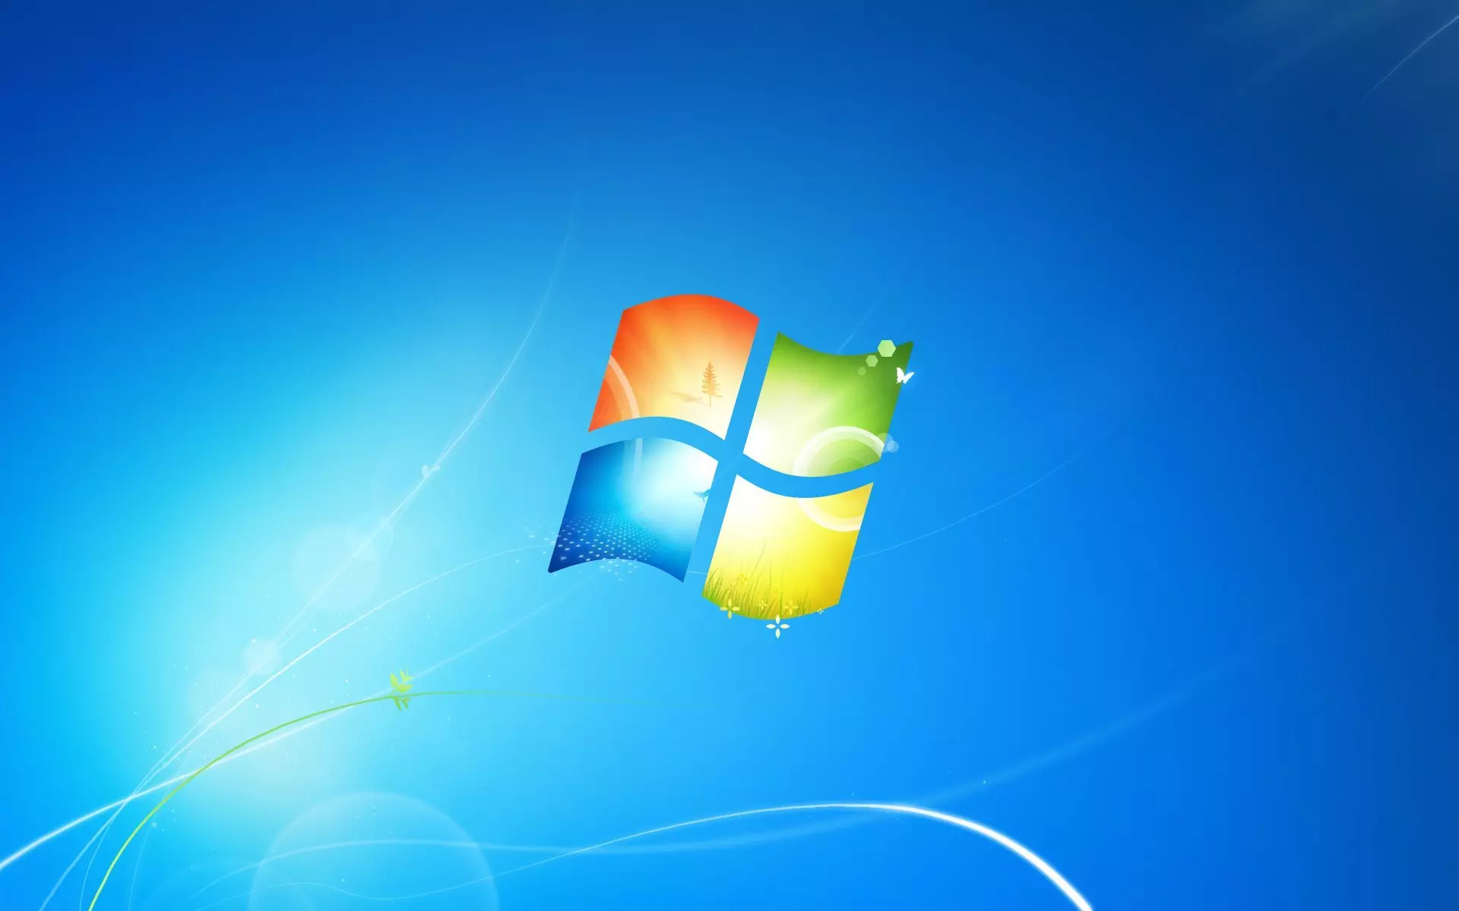

Windows 7

Slide 7
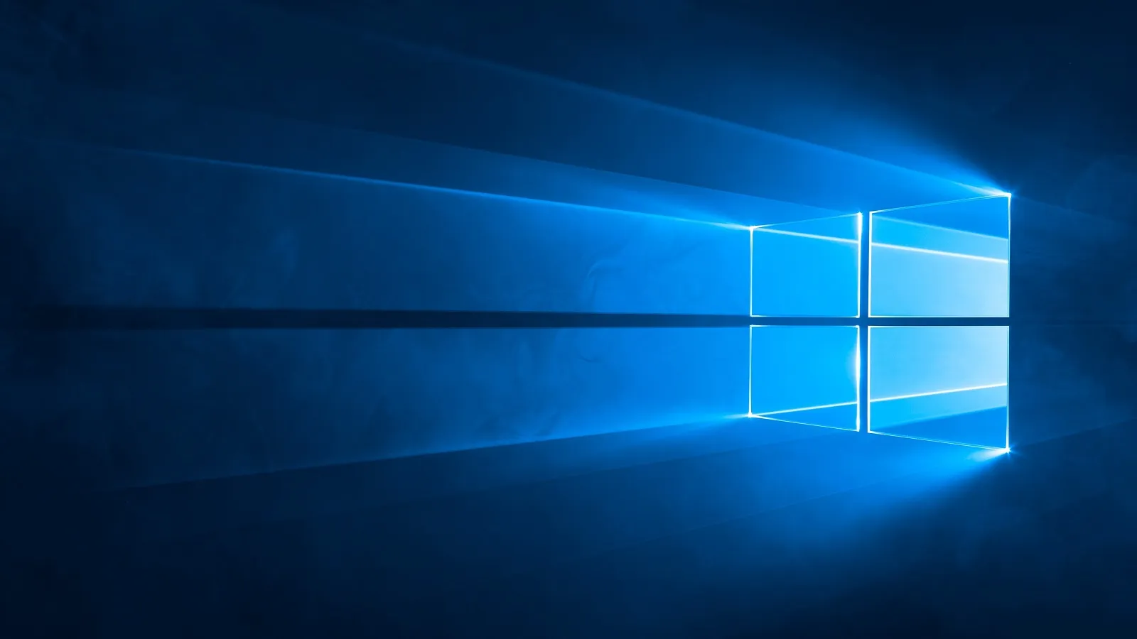

Windows 10

Slide 8


Windows 11

